Slide 1
HOW TO CHOOSE HARDWARE FOR YOUR PROJECT

Slide 2


Slide 3


Slide 4
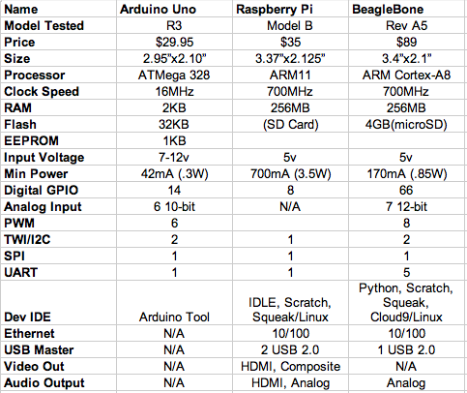

Slide 5
HOW TO MAKE RIGHT CHOICE ?

Slide 6
BATTERY
WIFI
COMPLEXITY
ETHERNET
OS
SPI
SETUP
DAC
GPIO
VIDEO
COST
BLUETOOTH
ADC
PWM
SOUND
COMMUNITY
MULTI-TASKING
SIZE
I2C
POWER
LANGUAGES
DOCUMENTATION
SPEED

Slide 7
MOST IMPORTANT
Features
Setup and Installation
Learning Curve
Community Support
Cost

Slide 8
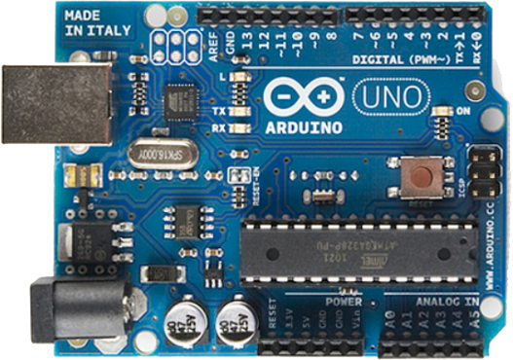
ARDUINO UNO
PROS
CONS
Simple IDE and programming language
Easy setup
Low power
Shields
Most widely used
Speed
Shield stack
Shield cost

Slide 9
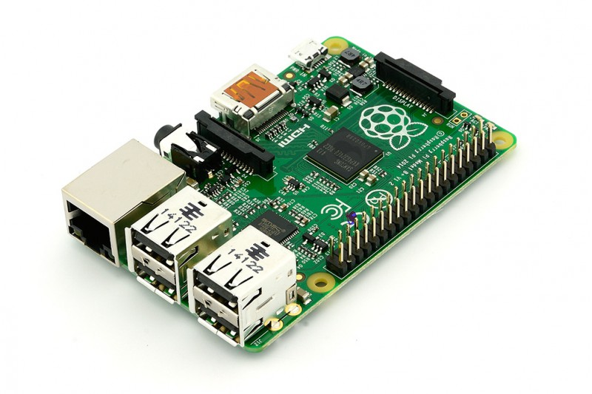
RASPBERRY PI
PROS
CONS
Linux
HD Video Support
Language support
Community Support
Ethernet Support
USB, camera, display
Linux
Power Consuming
Setup
Not Open

Slide 10
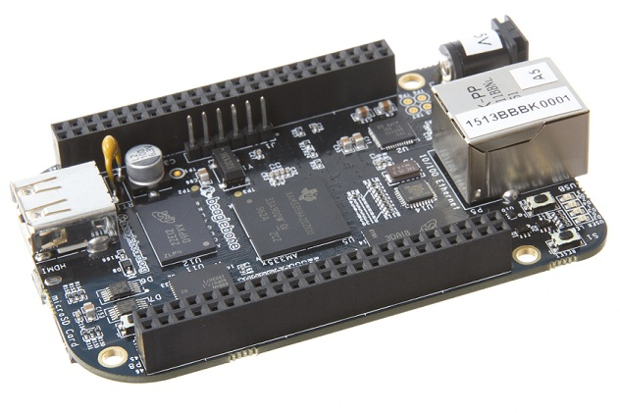
BEAGLEBONE
PROS
CONS
Linux
Language support
Image processing
Community Support
Low power
Shields
Open Hardware
Linux
Cost
Shield cost
setup

Slide 11
CHOOSING BOARD FOR YOUR PROJECT
The strongest features of the board should be easily manipulated to obtain the features of your project.
Power requirement
Community Support

Slide 12
WHY OPENSOURCE HARDWARE
Prototype to product conversion is easy

Slide 13


